Slide 1



Home
Projects
Resume
Calorie Tracker
Resume
Projects
About

Slide 2
Home
Projects
Resume
Calorie Tracker
Click below to add a new food item to you daily list
Add

Slide 3
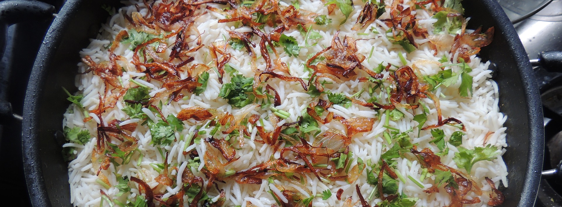
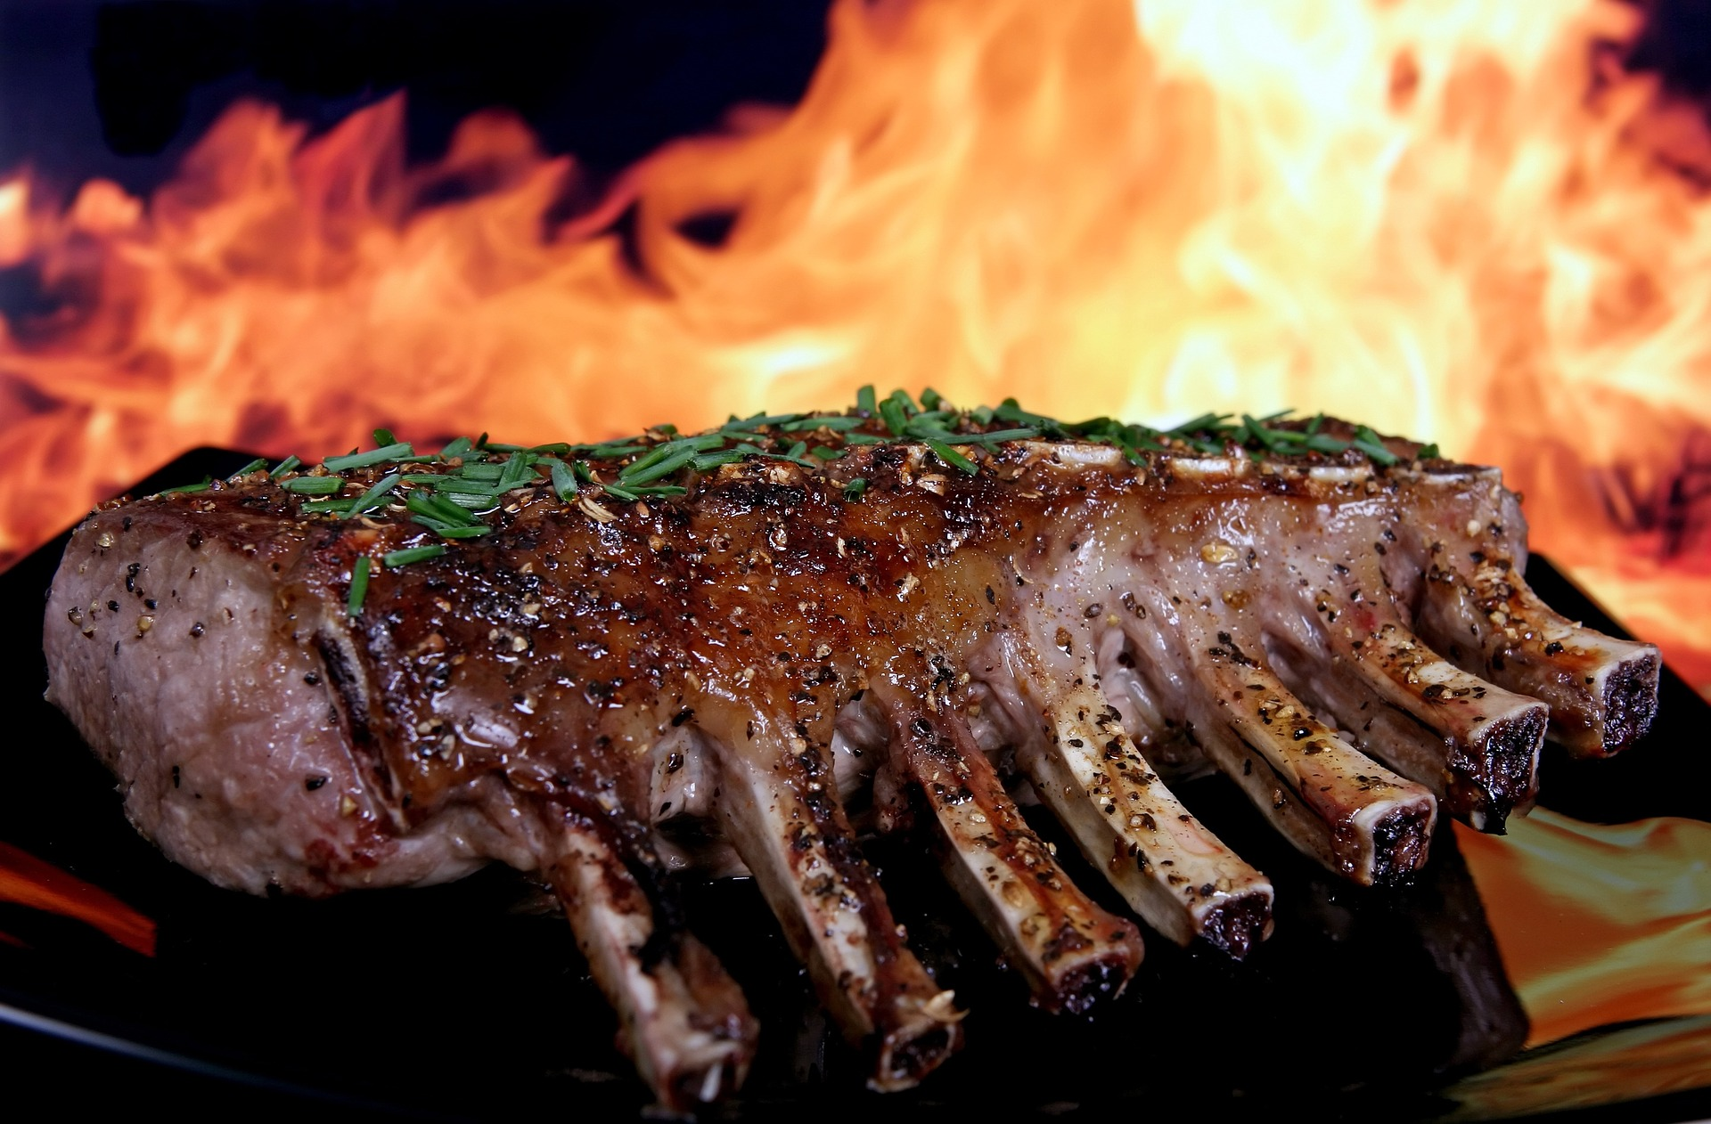

Home
Projects
Resume
Calorie Tracker
Search for day log...
Calorie Tracker
Add Food Item
I Just Went Shopping
1800
calories
Fat 70% 130g 1300 cal
Carbs 5% 22g 130 cal
Protein 25% 111g 450 cal
BreakFAST
400 Calories
Lunch
750 Calories
DINNER
1080 Calories
SNACKS
240 Calories

Slide 4


Home
Projects
Resume
Calorie Tracker
Search for day log...
Calorie Tracker
Add Food Item
I Just Went Shopping

Slide 5


Home
Projects
Resume
Calorie Tracker
Search for day log...
Calorie Tracker
Add Food Item
I Just Went Shopping
FAT
1835
calories
65%
CARBS
265
2100
5%
PROTEIN
30%
BreakFAST
400 Calories
Egg
x3
Fat
5.6g
Carbs
1.2g
Protein
3.6g
Calories
86
Bacon Strip
x2
Fat
5.6g
Carbs
1.2g
Protein
3.6g
Calories
86
Shredded Cheese
56g
Fat
5.6g
Carbs
1.2g
Protein
3.6g
Calories
86
Toast (Honey & Oat)
x1
Fat
5.6g
Carbs
1.2g
Protein
3.6g
Calories
86
Lunch
Toast (Whole Wheat Bread)
755 Calories
x3
Fat
5.6g
Carbs
1.2g
Protein
3.6g
Calories
86
Omlette
x1
Fat
5.6g
Carbs
1.2g
Protein
3.6g
Calories
86
Egg
x3
Fat
5.6g
Carbs
1.2g
Protein
3.6g
Calories
86
Shredded Cheese
56g
Fat
5.6g
Carbs
1.2g
Protein
3.6g
Calories
86
Cheese Stick
x1
Fat
5.6g
Carbs
1.2g
Protein
3.6g
Calories
86
Almonds
56g
Fat
5.6g
Carbs
1.2g
Protein
3.6g
Calories
86
DINNER
Buffalo Casserole
1209 Calories
86g
Fat
5.6g
Carbs
1.2g
Protein
3.6g
Calories
86
Buffalo Sauce
26g
Fat
5.6g
Carbs
1.2g
Protein
3.6g
Calories
86
Chicken Breast
86g
Fat
5.6g
Carbs
1.2g
Protein
3.6g
Calories
86
Salt
x3
Fat
5.6g
Carbs
1.2g
Protein
3.6g
Calories
86
Ice Cream
86g
Fat
5.6g
Carbs
1.2g
Protein
3.6g
Calories
86
Milk
56g
Fat
5.6g
Carbs
1.2g
Protein
3.6g
Calories
86

Slide 6
Home
Projects
Resume
Calorie Tracker
Search for day log...
Calorie Tracker
Add Food Item
I Just Went Shopping
1835
calories
FAT
CARBS
PROTEIN
265
2100
65%
5%
30%
BreakFAST
Egg
x3
Fat
5.6g
Carbs
1.2g
Protein
3.6g
Calories
86
Bacon Strip
x2
Fat
5.6g
Carbs
1.2g
Protein
3.6g
Calories
86
Shredded Cheese
56g
Fat
5.6g
Carbs
1.2g
Protein
3.6g
Calories
86
Toast (Honey & Oat)
x1
Fat
5.6g
Carbs
1.2g
Protein
3.6g
Calories
86
Lunch
Toast (Whole Wheat Bread)
x3
Fat
5.6g
Carbs
1.2g
Protein
3.6g
Calories
86
Omlette
x1
Fat
5.6g
Carbs
1.2g
Protein
3.6g
Calories
86
Egg
x3
Fat
5.6g
Carbs
1.2g
Protein
3.6g
Calories
86
Shredded Cheese
56g
Fat
5.6g
Carbs
1.2g
Protein
3.6g
Calories
86
Cheese Stick
x1
Fat
5.6g
Carbs
1.2g
Protein
3.6g
Calories
86
Almonds
56g
Fat
5.6g
Carbs
1.2g
Protein
3.6g
Calories
86
DINNER
Buffalo Casserole
86g
Fat
5.6g
Carbs
1.2g
Protein
3.6g
Calories
86
Buffalo Sauce
26g
Fat
5.6g
Carbs
1.2g
Protein
3.6g
Calories
86
Chicken Breast
86g
Fat
5.6g
Carbs
1.2g
Protein
3.6g
Calories
86
Salt
x3
Fat
5.6g
Carbs
1.2g
Protein
3.6g
Calories
86
Ice Cream
86g
Fat
5.6g
Carbs
1.2g
Protein
3.6g
Calories
86
Milk
56g
Fat
5.6g
Carbs
1.2g
Protein
3.6g
Calories
86
PROGRESS
Week
Month
Year
Add Weigh-In
Total Weight Loss
18.6 lbs
280
Current Weight
259.4
270
260
Goal Weight
225
250
Oct
Nov
Dec
Jan

Slide 7
Home
Calorie Tracker
Search for day log...
Calorie Tracker
Add Food Item
I Just Went Shopping
1835
calories
FAT
CARBS
PROTEIN
265
2100
65%
5%
30%
BreakFAST
Egg
x3
Fat
5.6g
Carbs
1.2g
Protein
3.6g
Calories
86
Bacon Strip
x2
Fat
5.6g
Carbs
1.2g
Protein
3.6g
Calories
86
Shredded Cheese
56g
Fat
5.6g
Carbs
1.2g
Protein
3.6g
Calories
86
Toast (Honey & Oat)
x1
Fat
5.6g
Carbs
1.2g
Protein
3.6g
Calories
86
Lunch
Toast (Whole Wheat Bread)
x3
Fat
5.6g
Carbs
1.2g
Protein
3.6g
Calories
86
Omlete
x1
Fat
5.6g
Carbs
1.2g
Protein
3.6g
Calories
86
Egg
x3
Fat
5.6g
Carbs
1.2g
Protein
3.6g
Calories
86
Shredded Cheese
56g
Fat
5.6g
Carbs
1.2g
Protein
3.6g
Calories
86
Cheese Stick
x1
Fat
5.6g
Carbs
1.2g
Protein
3.6g
Calories
86
Almonds
56g
Fat
5.6g
Carbs
1.2g
Protein
3.6g
Calories
86
DINNER
Buffalo Casserole
86g
Fat
5.6g
Carbs
1.2g
Protein
3.6g
Calories
86
Buffalo Sauce
26g
Fat
5.6g
Carbs
1.2g
Protein
3.6g
Calories
86
Chicken Breast
86g
Fat
5.6g
Carbs
1.2g
Protein
3.6g
Calories
86
Salt
x3
Fat
5.6g
Carbs
1.2g
Protein
3.6g
Calories
86
Ice Cream
86g
Fat
5.6g
Carbs
1.2g
Protein
3.6g
Calories
86
Milk
56g
Fat
5.6g
Carbs
1.2g
Protein
3.6g
Calories
86
PROGRESS
Week
Month
Year
Add Weigh-In
Total Weight Loss
18.6 lbs
280
Current Weight
259.4
270
Goal Weight
225
260
250
Oct
Nov
Dec
Jan

Slide 8
Home
Calorie Tracker
Search for day log...
Calorie Tracker
Add Food Item
I Just Went Shopping
1835
calories
FAT
CARBS
PROTEIN
265
2100
65%
5%
30%
BreakFAST
Egg
x3
Fat
5.6g
Carbs
1.2g
Protein
3.6g
Calories
86
Bacon Strip
x2
Fat
5.6g
Carbs
1.2g
Protein
3.6g
Calories
86
Shredded Cheese
56g
Fat
5.6g
Carbs
1.2g
Protein
3.6g
Calories
86
Toast (Honey & Oat)
x1
Fat
5.6g
Carbs
1.2g
Protein
3.6g
Calories
86
Lunch
Toast (Whole Wheat Bread)
x3
Fat
5.6g
Carbs
1.2g
Protein
3.6g
Calories
86
Omlete
x1
Fat
5.6g
Carbs
1.2g
Protein
3.6g
Calories
86
Egg
x3
Fat
5.6g
Carbs
1.2g
Protein
3.6g
Calories
86
Shredded Cheese
56g
Fat
5.6g
Carbs
1.2g
Protein
3.6g
Calories
86
Cheese Stick
x1
Fat
5.6g
Carbs
1.2g
Protein
3.6g
Calories
86
Almonds
56g
Fat
5.6g
Carbs
1.2g
Protein
3.6g
Calories
86
DINNER
Buffalo Casserole
86g
Fat
5.6g
Carbs
1.2g
Protein
3.6g
Calories
86
Buffalo Sauce
26g
Fat
5.6g
Carbs
1.2g
Protein
3.6g
Calories
86
Chicken Breast
86g
Fat
5.6g
Carbs
1.2g
Protein
3.6g
Calories
86
Salt
x3
Fat
5.6g
Carbs
1.2g
Protein
3.6g
Calories
86
Ice Cream
86g
Fat
5.6g
Carbs
1.2g
Protein
3.6g
Calories
86
Milk
56g
Fat
5.6g
Carbs
1.2g
Protein
3.6g
Calories
86
PROGRESS
Week
Month
Year
Add Weigh-In
Total Weight Loss
18.6 lbs
280
Current Weight
259.4
270
Goal Weight
225
260
250
Oct
Nov
Dec
Jan

